Slide 1
Fundamentals of Java Programming
TE (E&TC) 2019 Course

Slide 2
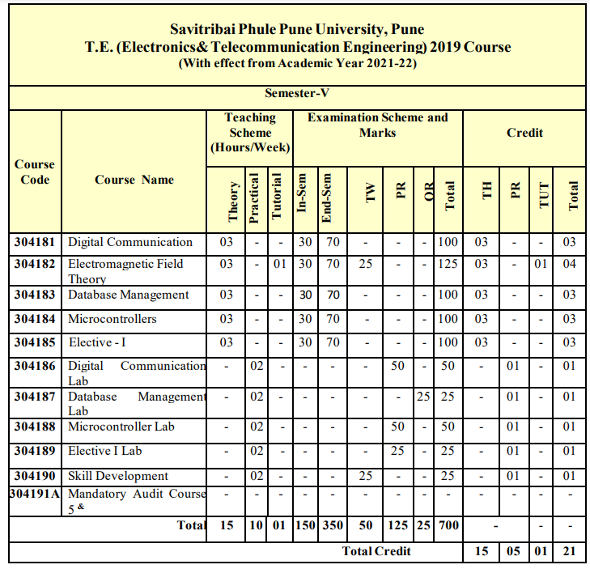

Slide 3
Unit I Java Fundamentals (08 Hrs)
● Object Oriented Concepts
● Evolution of Java
● Java Features
● Java and WWW, JRE, JVM Architecture
● Overview of Java Language
● Java Program Structure
● Java Token, Statements, Constants, Variables, Data Types
● Arrays, Typecasting, Operators, Expressions
● Control Statements

Slide 4
To be proficient in a programming language, you need to master two things:
The syntax of the programming language: Not too difficult to learn a small set of keywords and syntaxes.
For examples, JDK 1.8 has 48 keywords; C11 has 44, and C++11 has 73.
The Application Program Interface (API) libraries associated with the language
“Write Once Run Anywhere”

Slide 5
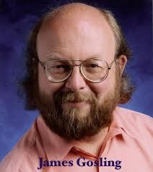
History of Java
Java was originally designed for interactive television, but it was too advanced technology for the digital cable television industry at the time.
The principles for creating Java programming were "Simple, Robust, Portable, Platform-independent, Secured, High Performance, Multithreaded, Architecture Neutral, Object-Oriented, Interpreted, and Dynamic".
Java was developed by James Gosling, who is known as the father of Java, in 1995. James Gosling and his team members started the project in the early 90’s.
Currently, Java is used in internet programming, mobile devices, games, e-business solutions, etc. There are given significant points that describe the history of Java.

Slide 6
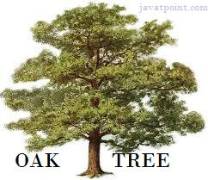
James Gosling, Mike Sheridan, and Patrick Naughton initiated the Java language project in June 1991. The small team of sun engineers called Green Team.
Initially designed for small, embedded systems in electronic appliances
like set-top boxes.
Firstly, it was called "Greentalk" by James Gosling and the file extension was .gt.
After that, it was called Oak and was developed as a part of the Green project.
Why Java named "Oak"?
Oak is a symbol of strength and chosen as a national tree of many countries like the U.S.A., France, Germany, Romania, etc.
In 1995, Oak was renamed as "Java" because it was already a trademark by Oak Technologies.

Slide 7
What is JAVA?
Java is a high-level, general-purpose, object-oriented, and secure programming language developed by James Gosling at Sun Microsystems, Inc. in 1991.
It is formally known as OAK. In 1995, Sun Microsystem changed the name to Java.
In 2009, Sun Microsystem takeover by Oracle Corporation.
Editions of Java
Each edition of Java has different capabilities. There are three editions of Java:
Java Standard Editions (JSE):
It is used to create programs for a desktop computer.
It is a Java programming platform. It includes Java programming APIs such as java.lang, java.io, java.net, java.util, java.sql, java.math etc. It includes core topics like OOPs, String, Regex, Exception, Inner classes, Multithreading, I/O Stream, Networking, AWT, Swing, Reflection, Collection, etc.
Java Enterprise Edition (JEE):
It is used to create large programs that run on the server and manages heavy traffic and complex transactions.
It is an enterprise platform which is mainly used to develop web and enterprise applications. It is built on the top of the Java SE platform. It includes topics like Servlet, JSP, Web Services, EJB, JPA, etc.
Java Micro Edition (JME):
It is used to develop applications for small devices such as set-top boxes, phone, and appliances. It is a micro platform which is mainly used to develop mobile applications.
JavaFX : It is used to develop rich internet applications. It uses a light-weight user interface API.

Slide 8
Types of Java Applications
There are four types of Java applications that can be created using Java programming:
Standalone Applications:
Java standalone applications uses GUI components such as AWT, Swing, and JavaFX. These components contain buttons, list, menu, scroll panel, etc. It is also known as desktop alienations.
Enterprise Applications:
An application which is distributed in nature is called enterprise applications.
Web Applications:
An applications that run on the server is called web applications. We use JSP, Servlet, Spring, and Hibernate technologies for creating web applications.
Mobile Applications:
Java ME is a cross-platform to develop mobile applications which run across smartphones. Java is a platform for App Development in Android.

Slide 9
Comparision of JAVA with other programming languages:
Java is one of the most popular and widely used programming language and platform. A platform is an environment that helps to develop and run programs written in any programming language.
Java is fast, reliable and secure. From desktop to web applications, scientific supercomputers to gaming consoles, cell phones to the Internet, Java is used in every nook and corner.
Here we are comparing other languages (Python, C++) with Java.
PYTHON
Python is a high-level language. It fully supports object-oriented programming. Python is not a pure object-oriented language.
Python is an interpreted language whereas Java is not an interpreted language, it is a compiled language.
Python is a scripting language whereas JAVA is a low-level implementation language.
Python is easy to use whereas JAVA is not as simple as Python. Programmers prefer to use python instead of Java because python contains less line of code whereas Java is just opposite to it.
Python programs are much shorter than JAVA programs.
Python is widely used in companies for building projects as its programs are shorter whereas JAVA is rarely used in companies for projects because it is difficult to use.
Python supports dynamic typing which is very useful for the programmers because they need to write less code because of which their time is saved and which is user-friendly as well as programmer-friendly. But in the case of JAVA, developers are required to define the type of each variable before using it which consumes the programmer’s lots of time.
Many large organizations like Google, Yahoo, NASA, etc. are making use of Python. But Python programs are generally expected to run slower than Java programs.
Java has much better library support for some use cases than Python which is the biggest advantage of JAVA.
Python is very much slower than Java.

Slide 10
C++
Java was basically derived from C++.
C++ is both procedural and object-oriented programming language whereas Java is a pure object-oriented language.
Both the languages have different objectives which means it has many differences too.
The main objective of C++ is to design a system of programming.
Java doesn’t support operator overloading but C++ does support it.
C++ also extends the C programming language whereas Java is basically created to support network computing.
Java doesn’t support structures and unions where C++ does support it.
Java is much slower than C++ in terms of execution.
C++ libraries are simple and also they are robust. It also provides container and associative arrays. But Java contains a powerful cross-platform library.
In Java, there is an automatic garbage collection whereas this is not the case in C++. In C++ all objects are destroyed manually with the help of the code.
C++ supports pointers which are variables which store addresses of other variables. But Java does not have any kind of variable which stores addresses of other variables.
C++ executes its programs very fast compared to Java.

Slide 11
To run a java program:
JDK
The Java Development Kit (JDK) is an implementation of either one of the
Java Platform, Standard Edition,
Java Platform, Enterprise Edition OR
Java Platform, Micro Edition platforms released by Oracle Corporation in the form of a binary product aimed at Java developers on Solaris, Linux, macOS or Windows.
Programming Text Editor
Do NOT use Notepad (Windows) or TextEdit (macOS) for programming.
Install a programming text editor, which does syntax color highlighting. For example,
For Windows: Sublime Text, Atom, NotePad++, TextPad.
For macOS: Sublime Text, Atom, jEdit, gEdit.
For Ubuntu: gEdit.

Slide 12
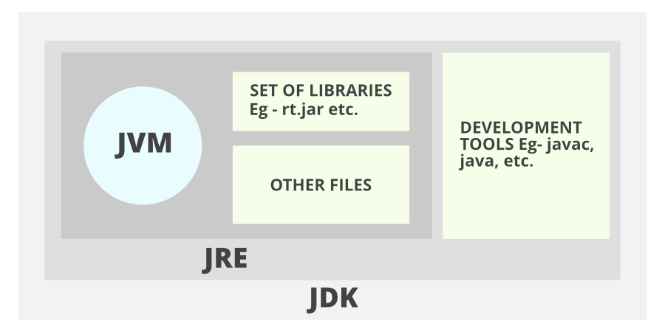
1. JDK (Java Development Kit) is a Kit that provides the environment to develop and execute(run) the Java program. JDK is a kit(or package) that includes two things Development Tools(to provide an environment to develop your java programs) JRE (to execute your java program).

Slide 13
2. JRE (Java Runtime Environment) is an installation package that provides an environment to only run(not develop) the java program(or application)onto your machine. JRE is only used by those who only want to run Java programs that are end-users of your system. 3. JVM (Java Virtual Machine) is a very important part of both JDK and JRE because it is contained or inbuilt in both. Whatever Java program you run using JRE or JDK goes into JVM and JVM is responsible for executing the java program line by line, hence it is also known as an interpreter.

Slide 14
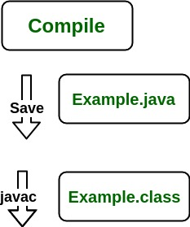
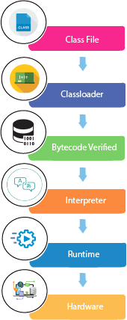
Consider a java source file saved as ‘Example.java’. The file is compiled into a set of Byte Code that is stored in a “.class” file. Here it will be “Example.class“.
The following actions occur at runtime as listed below:
Byte Code Verifier
Class Loader
Interpreter
Execute the Byte Code
Make appropriate calls to the underlying hardware

Slide 15
JVM becomes an instance of JRE at the runtime of a Java program. It is widely known as a runtime interpreter.
JVM largely helps in the abstraction of inner implementation from the programmers who make use of libraries for their programs from JDK.
It is mainly responsible for three activities.
Loading
Linking
Initialization
Working of JRE is as follows:
JVM(Java Virtual Machine) acts as a run-time engine to run Java applications. JVM is the one that actually calls the main method present in a java code. JVM is a part of JRE(Java Runtime Environment).
Java applications are called WORA (Write Once Run Anywhere). This means a programmer can develop Java code on one system and can expect it to run on any other Java-enabled system without any adjustments. This is all possible because of JVM.
When we compile a .java file, .class files(contains byte-code) with the same class names present in .java file are generated by the Java compiler.
This .class file goes into various steps when we run it. These steps together describe the whole JVM.

Slide 16
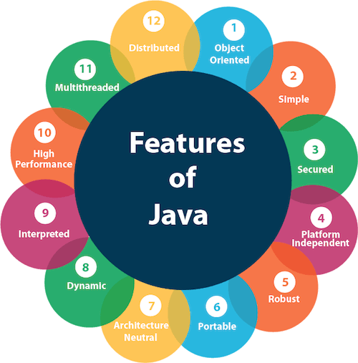
Features of Java
The primary objective of Java programming language creation was to make it portable, simple and secure programming language.
A list of most important features of Java language is given below.
Simple
Object-Oriented
Portable
Platform independent
Secured
Robust
Architecture neutral
Interpreted
High Performance
Multithreaded
Distributed
Dynamic

Slide 17
Simple
Java is very easy to learn, and its syntax is simple, clean and easy to understand. According to Sun, Java language is a simple programming language because:
Java syntax is based on C++ (so easier for programmers to learn it after C++).
Java has removed many complicated and rarely-used features, for example, explicit pointers, operator overloading, etc.
There is no need to remove unreferenced objects because there is an Automatic Garbage Collection in Java.
Object-oriented
Java is an object-oriented programming language. Everything in Java is an object. Object-oriented means we organize our software as a combination of different types of objects that incorporates both data and behavior.
Object-oriented programming (OOPs) is a methodology that simplifies software development and maintenance by providing some rules.
Basic concepts of OOPs are:HTML Tutorial
Object
Class
Inheritance
Polymorphism
Abstraction
Encapsulation

Slide 18
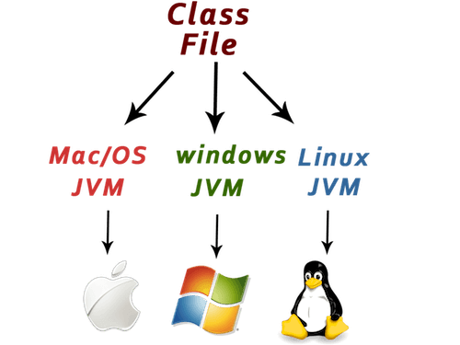
Platform Independent
Java is platform independent because it is different from other languages like C, C++, etc. which are compiled into platform specific machines while Java is a write once, run anywhere language. A platform is the hardware or software environment in which a program runs.
There are two types of platforms software-based and hardware-based. Java provides a software-based platform.
The Java platform differs from most other platforms in the sense that it is a software-based platform that runs on the top of other hardware-based platforms. It has two components:
Runtime Environment
API(Application Programming Interface)
Java code can be run on multiple platforms, for example, Windows, Linux, Sun Solaris, Mac/OS, etc. Java code is compiled by the compiler and converted into bytecode. This bytecode is a platform-independent code because it can be run on multiple platforms, i.e., Write Once and Run Anywhere(WORA).

Slide 19
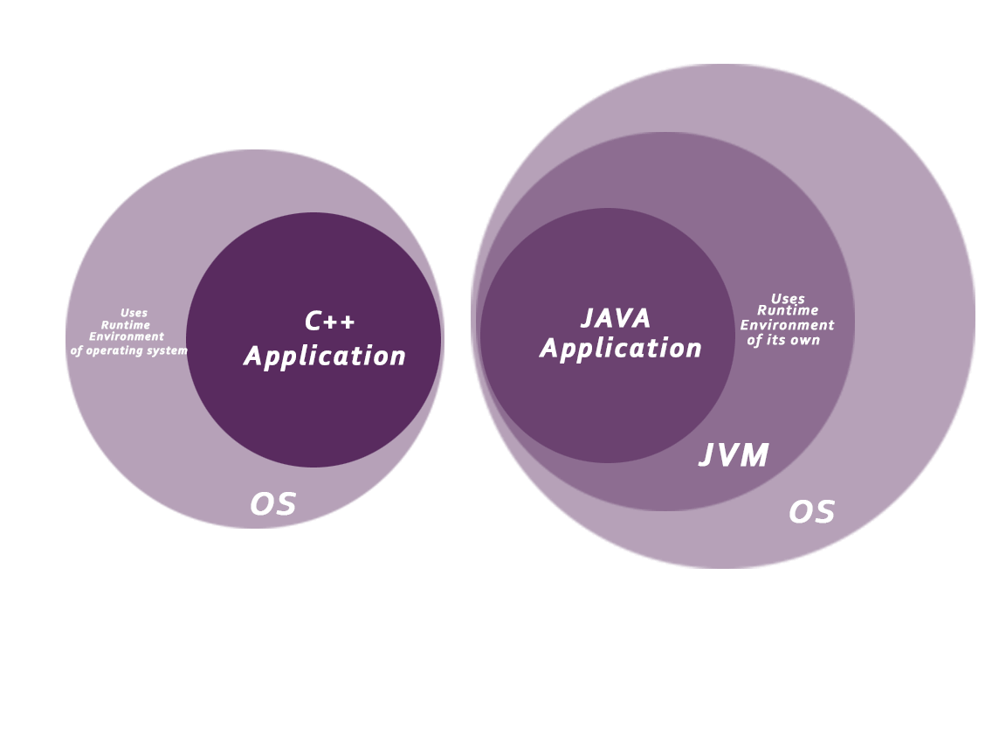
Secured
Java is best known for its security. With Java, we can develop virus-free systems. Java is secured because:
No explicit pointer
Java Programs run inside a virtual machine sandbox
Classloader: Classloader in Java is a part of the Java Runtime Environment(JRE) which is used to load Java classes into the Java Virtual Machine dynamically. It adds security by separating the package for the classes of the local file system from those that are imported from network sources.
Bytecode Verifier: It checks the code fragments for illegal code that can violate access right to objects.
Security Manager: It determines what resources a class can access such as reading and writing to the local disk.
Java language provides these securities by default. Some security can also be provided by an application developer explicitly through SSL(secure socket layer), JAAS(java authentication and authorization service), Cryptography, etc.

Slide 20
Robust
Robust simply means strong. Java is robust because:
It uses strong memory management.
There is a lack of pointers that avoids security problems. There is automatic garbage collection in java which runs on the Java Virtual Machine to get rid of objects which are not being used by a Java application anymore.
There are exception handling and the type checking mechanism in Java. All these points make Java robust.
Architecture-neutral
Java is architecture neutral because there are no implementation dependent features, for example, the size of primitive types is fixed.
In C programming, int data type occupies 2 bytes of memory for 32-bit architecture and 4 bytes of memory for 64-bit architecture. However, it occupies 4 bytes of memory for both 32 and 64-bit architectures in Java.
Portable
Java is portable because it facilitates you to carry the Java bytecode to any platform. It doesn't require any implementation.
High-performance
Java is faster than other traditional interpreted programming languages because Java bytecode is "close" to native code. It is still a little bit slower than a compiled language (e.g., C++). Java is an interpreted language that is why it is slower than compiled languages, e.g., C, C++, etc.

Slide 21
Distributed
Java is distributed because it facilitates users to create distributed applications in Java. RMI and EJB are used for creating distributed applications. This feature of Java makes us able to access files by calling the methods from any machine on the internet.
Multi-threaded
A thread is like a separate program, executing concurrently. We can write Java programs that deal with many tasks at once by defining multiple threads. The main advantage of multi-threading is that it doesn't occupy memory for each thread. It shares a common memory area. Threads are important for multi-media, Web applications, etc.

Slide 22
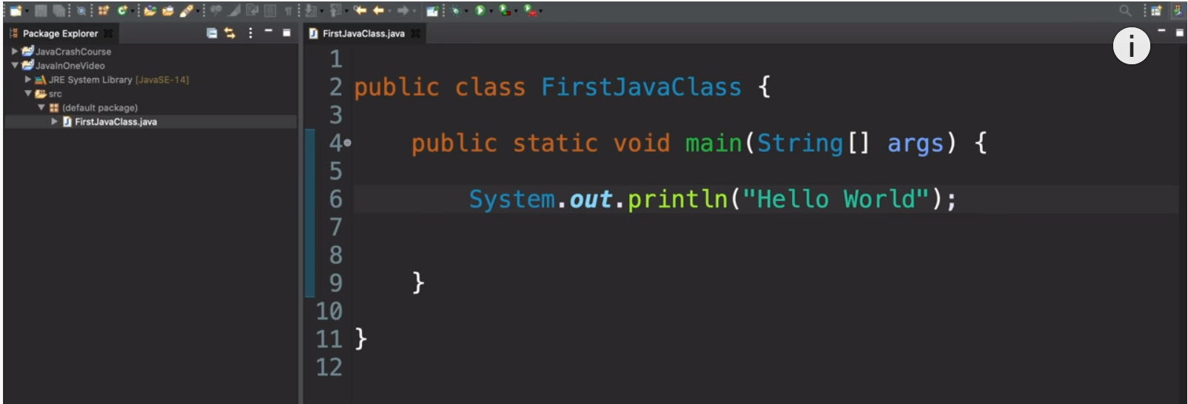
To write 1st JAVA program
Step 1: Write the Source Code:
Enter the following source codes, which defines a class called "Hello", using a programming text editor.
Save the source file as "Hello.java".
A Java source file should be saved with a file extension of ".java".
The filename shall be the same as the classname - in this case "Hello".
Filename and classname are case-sensitive.
1 2 3 4 5 6 7 8 | /* * First Java program, which says hello. */ public class Hello { // Save as "Hello.java" public static void main(String[] args) { // Program entry point System.out.println("Hello, world!"); // Print text message } }

Slide 23
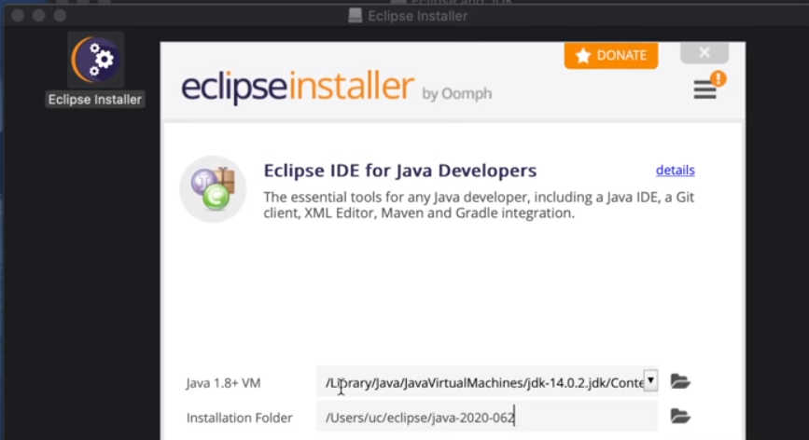
Step 2: Compile the Source Code: Compile the source code "Hello.java" into Java bytecode (or machine code) "Hello.class" using JDK's Java Compiler "javac".
Start a CMD Shell (Windows) or Terminal (UNIX/Linux/macOS) and issue these commands:
// Change directory (cd) to the directory (folder) containing the source file "Hello.java“
javac Hello.java

Slide 24
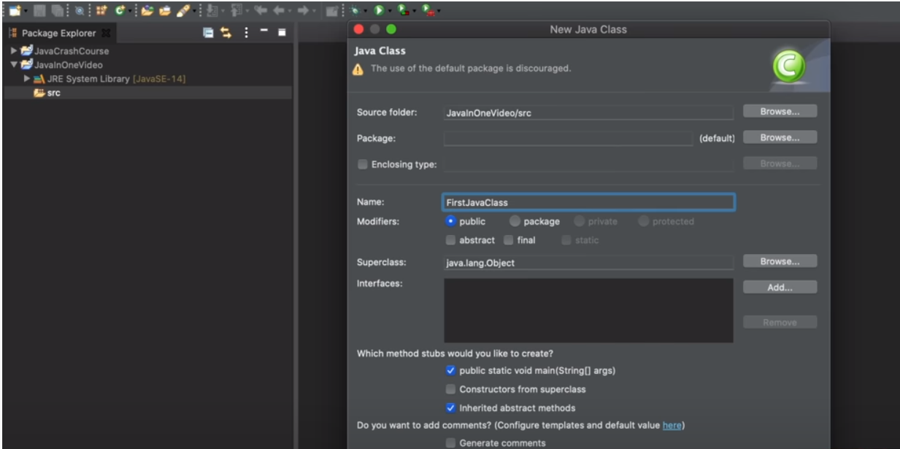
Step 3: Run the Program: Run the machine code using JDK's Java Runtime "java", by issuing this command:
java Hello
Hello, world!

Slide 25
Java Terminology and Syntax
Comments:
Comments are NOT executable and are ignored by the compiler. But they provide useful explanation and documentation to your readers (and to yourself three days later). There are two kinds of comments:
Multi-Line Comment: begins with /* and ends with */, and may span more than one lines.
End-of-Line (Single-Line) Comment: begins with // and lasts until the end of the current line
Statement:
A programming statement performs a single piece of programming action. It is terminated by a semi-colon (;), just like an English sentence is ended with a period, as in Lines 6.
Block:
A block is a group of programming statements enclosed by a pair of braces {}. This group of statements is treated as one single unit. There are two blocks in the above program. One contains the body of the class Hello. The other contains the body of the main() method. There is no need to put a semi-colon after the closing brace.
Whitespaces:
Blank, tab, and newline are collectively called whitespace. Extra whitespaces are ignored, i.e., only one whitespace is needed to separate the tokens. Nonetheless, extra whitespaces improve the readability, extra spaces and newlines should be used to improve the readability of your code.

Slide 26
Case Sensitivity:
Java is case sensitive - a ROSE is NOT a Rose, and is NOT a rose. The filename, which is the same as the class name, is also case-sensitive.
class:
The basic unit of a Java program is a class. A class called "Hello" is defined via the keyword "class". The braces {......} encloses the body of the class.
In Java, the name of the source file must be the same as the name of the class with a mandatory file extension of ".java". Hence, this file MUST be saved as "Hello.java" - case-sensitive.
main() method, which is the entry point for program execution. Again, the braces {......} encloses the body of the method, which contains programming statements.

Slide 27
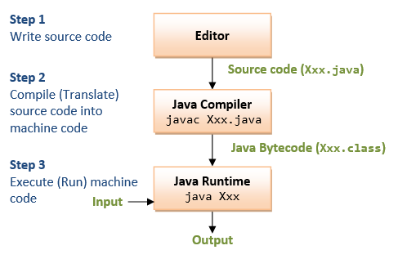
Java Programming Steps
The steps in writing a Java program is illustrated as above:
Step 1: Write the source code "Xxx.java".
Step 2: Compile the source code "Xxx.java" into Java portable bytecode (or machine code) "Xxx.class" using the JDK's Java compiler by issuing the command "javac Xxx.java".
Step 3: Run the compiled bytecode "Xxx.class", using the JDK's Java Runtime by issuing the command "java Xxx".

Slide 28
What is a Program?
A program is a sequence of instructions (called programming statements), executing one after another in a predictable manner.

Slide 29
Parameters used in First Java Program
class keyword is used to declare a class in java.
public keyword is an access modifier which represents visibility. It means it is visible to all.
static is a keyword. If we declare any method as static, it is known as the static method. The core advantage of the static method is that there is no need to create an object to invoke the static method. The main method is executed by the JVM (Java virtual machine), so it doesn't require to create an object to invoke the main method. So it saves memory.
void is the return type of the method. It means it doesn't return any value.
main represents the starting point of the program.
String[] args is used for command line argument. We will learn it later.
System.out.println() is used to print statement. Here, System is a class, out is the object of PrintStream class, println() is the method of PrintStream class.

Slide 30
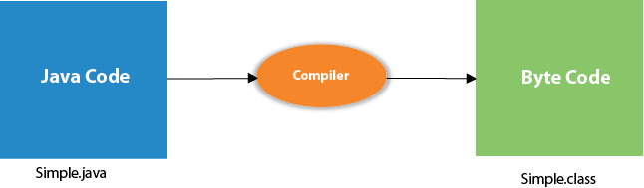
What happens at compile time?
At compile time, java file is compiled by Java Compiler (It does not interact with OS) and converts the java code into bytecode.

Slide 31
What happens at runtime?
At runtime, following steps are performed:
Classloader: is the subsystem of JVM that is used to load class files.
Bytecode Verifier: checks the code fragments for illegal code that can violate access right to objects.
Interpreter: read bytecode stream then execute the instructions.

Slide 32
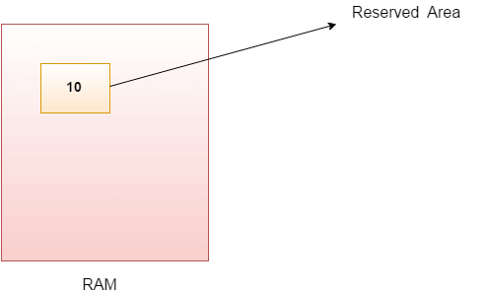
Java Variables
A variable is a container which holds the value while the Java program is executed. A variable is assigned with a data type.
Variable is a name of memory location. There are three types of variables in java: local, instance and static.
Variable
Variable is name of reserved area allocated in memory. In other words, it is a name of memory location. It is a combination of "vary + able" that means its value can be changed.
int data=50;//Here data is variable
Types of Variables
There are three types of variables in Java:
local variable
instance variable
static variable

Slide 33
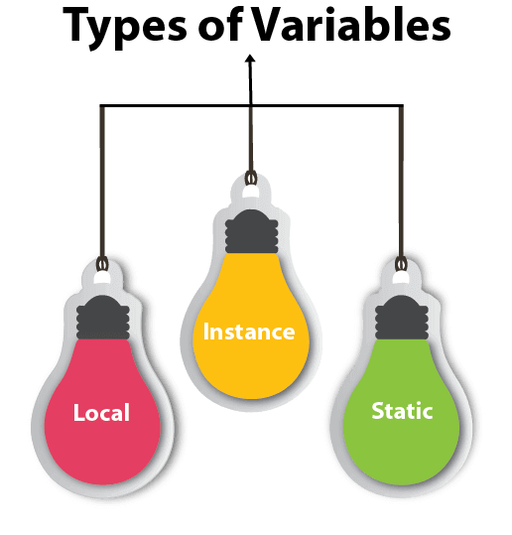
1) Local Variable
A variable declared inside the body of the method is called local variable. You can use this variable only within that method and the other methods in the class aren't even aware that the variable exists.C++ vs Java
A local variable cannot be defined with "static" keyword.
2) Instance Variable
A variable declared inside the class but outside the body of the method, is called instance variable. It is not declared as static.
It is called instance variable because its value is instance specific and is not shared among instances.
3) Static variable
A variable which is declared as static is called static variable. It cannot be local. You can create a single copy of static variable and share among all the instances of the class. Memory allocation for static variable happens only once when the class is loaded in the memory.

Slide 34
Data Types in Java
Data types specify the different sizes and values that can be stored in the variable. There are two types of data types in Java:
Primitive data types: The primitive data types include boolean, char, byte, short, int, long, float and double.
Non-primitive data types: The non-primitive data types include Classes, Interfaces, and Arrays.
Java Primitive Data Types
In Java language, primitive data types are the building blocks of data manipulation. These are the most basic data types available in Java language.
Java is a statically-typed programming language. It means, all variables must be declared before its use. That is why we need to declare variable's type and name.
There are 8 types of primitive data types:
boolean data type
byte data type
char data type
short data type
int data type
long data type
float data type
double data type

Slide 35
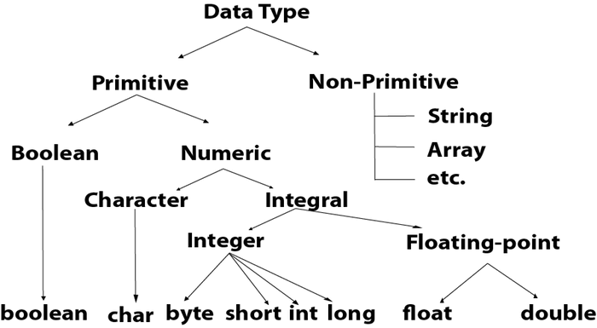

Slide 36
Data Type | Default Value | Default size
boolean | false | 1 bit
char | '\u0000' | 2 byte
byte | 0 | 1 byte
short | 0 | 2 byte
int | 0 | 4 byte
long | 0L | 8 byte
float | 0.0f | 4 byte
double | 0.0d | 8 byte

Slide 37
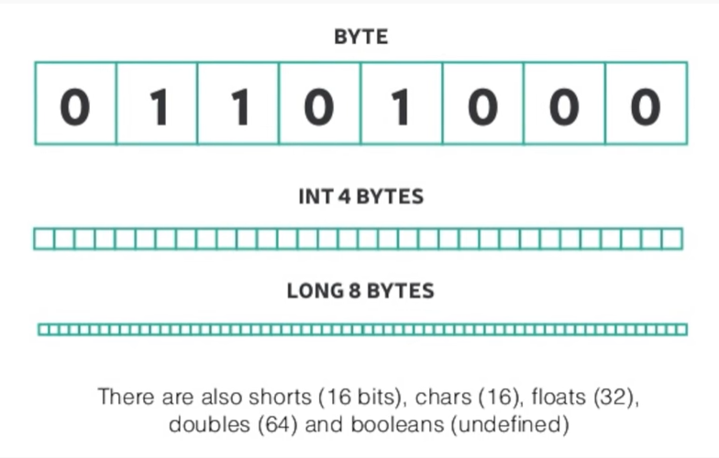

Slide 38
Boolean Data Type
The Boolean data type is used to store only two possible values: true and false.
This data type is used for simple flags that track true/false conditions.
The Boolean data type specifies one bit of information, but its "size" can't be defined precisely.Difference between JDK, JRE, and JVM
Example:
Boolean one = false

Slide 39
Byte Data Type
The byte data type is an example of primitive data type.
It is an 8-bit signed two's complement integer. Its value-range lies between -128 to 127 (inclusive).
Its minimum value is -128 and maximum value is 127.
Its default value is 0.
The byte data type is used to save memory in large arrays where the memory savings is most required.
It saves space because a byte is 4 times smaller than an integer. It can also be used in place of "int" data type.
Example:
byte a = 10, byte b = -20

Slide 40
Short Data Type
The short data type is a 16-bit signed two's complement integer.
Its value-range lies between -32,768 to 32,767 (inclusive).
Its minimum value is -32,768 and maximum value is 32,767.
Its default value is 0.
The short data type can also be used to save memory just like byte data type.
A short data type is 2 times smaller than an integer.
Example:
short s = 10000, short r = -5000

Slide 41
Int Data Type
The int data type is a 32-bit signed two's complement integer.
Its value-range lies between - 2,147,483,648 (-2^31) to 2,147,483,647 (2^31 -1) (inclusive).
Its minimum value is - 2,147,483,648 and maximum value is 2,147,483,647.
Its default value is 0.
The int data type is generally used as a default data type for integral values unless if there is no problem about memory.
Example:
int a = 100000, int b = -200000

Slide 42
Long Data Type
The long data type is a 64-bit two's complement integer.
Its value-range lies between -9,223,372,036,854,775,808(-2^63) to 9,223,372,036,854,775,807(2^63 -1)(inclusive).
Its minimum value is - 9,223,372,036,854,775,808and maximum value is 9,223,372,036,854,775,807.
Its default value is 0.
The long data type is used when you need a range of values more than those provided by int.
Example:
long a = 100000L, long b = -200000L

Slide 43
Float Data Type
The float data type is a single-precision 32-bit IEEE 754 floating point.
Its value range is unlimited. It is recommended to use a float (instead of double) if you need to save memory in large arrays of floating point numbers.
The float data type should never be used for precise values, such as currency.
Its default value is 0.0F.
Example:
float f1 = 234.5f

Slide 44
Double Data Type
The double data type is a double-precision 64-bit IEEE 754 floating point. Its value range is unlimited.
The double data type is generally used for decimal values just like float.
The double data type also should never be used for precise values, such as currency. Its default value is 0.0d.
Example:
double d1 = 12.3

Slide 45
Char Data Type
The char data type is a single 16-bit Unicode character.
Its value-range lies between '\u0000' (or 0) to '\uffff' (or 65,535 inclusive).\
The char data type is used to store characters.
Example:
char letterA = 'A'
Why char uses 2 byte in java and what is \u0000 ?
It is because java uses Unicode system not ASCII code system. The \u0000 is the lowest range of Unicode system.
Unicode System
Unicode is a universal international standard character encoding that is capable of representing most of the world's written languages.

Slide 46
Why java uses Unicode System?
Before Unicode, there were many language standards:
ASCII (American Standard Code for Information Interchange) for the United States.
ISO 8859-1 for Western European Language.
KOI-8 for Russian.
GB18030 and BIG-5 for chinese, and so on.
Problem
This caused two problems:
A particular code value corresponds to different letters in the various language standards.
The encodings for languages with large character sets have variable length. Some common characters are encoded as single bytes, other require two or more byte.
Solution
To solve these problems, a new language standard was developed i.e. Unicode System.
In unicode, character holds 2 byte, so java also uses 2 byte for characters
lowest value:\u0000 highest value:\uFFFF

Slide 47
Operators in Java
Operator in Java is a symbol which is used to perform operations. For example: +, -, *, / etc.
There are many types of operators in Java which are given below:
Unary Operator,
Arithmetic Operator,
Shift Operator,
Relational Operator,
Bitwise Operator,
Logical Operator,
Ternary Operator and
Assignment Operator.

Slide 48
Java Operator Precedence
Operator Type | Category | Precedence
Unary | postfix | expr++ expr--
 | prefix | ++expr --expr +expr -expr ~ !
Arithmetic | multiplicative | * / %
 | additive | + -
Shift | shift | << >> >>>
Relational | comparison | < > <= >= instanceof
 | equality | == !=
Bitwise | bitwise AND | &
 | bitwise exclusive OR | ^
 | bitwise inclusive OR | |
Logical | logical AND | &&
 | logical OR | ||
Ternary | ternary | ? :
Assignment | assignment | = += -= *= /= %= &= ^= |= <<= >>= >>>=

Slide 49
Java Unary Operator
The Java unary operators require only one operand. Unary operators are used to perform various operations i.e.:
incrementing/decrementing a value by one
negating an expression
inverting the value of a boolean
Java Unary Operator Example: ++ and --
class OperatorExample{
public static void main(String args[]){
int x=10;
System.out.println(x++);//10 (11)
System.out.println(++x);//12
System.out.println(x--);//12 (11)
System.out.println(--x);//10
}}
Output:
10
12
12
10

Slide 50
Java Unary Operator Example 2: ++ and --
class OperatorExample{
public static void main(String args[]){
int a=10;
int b=10;
System.out.println(a++ + ++a); //10+12=22
System.out.println(b++ + b++); //10+11=21
}}
Output:
22
21

Slide 51
Java Unary Operator Example: ~ and !
class OperatorExample{
public static void main(String args[]){
int a=10;
int b=-10;
boolean c=true;
boolean d=false;
System.out.println(~a);//-11 (minus of total positive value which starts from 0)
System.out.println(~b);//9 (positive of total minus, positive starts from 0)
System.out.println(!c);//false (opposite of boolean value)
System.out.println(!d);//true
}}
Output:
-11
9
false
true
Equals –x-1
Notes:
-11 9 false true

Slide 52
Java Arithmetic Operator Example
class OperatorExample{
public static void main(String args[]){
int a=10;
int b=5;
System.out.println(a+b);//15
System.out.println(a-b);//5
System.out.println(a*b);//50
System.out.println(a/b);//2
System.out.println(a%b);//0
}}
Output:
15
5
50
2
0

Slide 53
Java Arithmetic Operator Example: Expression
class OperatorExample{
public static void main(String args[]){
System.out.println(10*10/5+3-1*4/2);
}}
Output:
21

Slide 54
Java Left Shift Operator
The Java left shift operator << is used to shift all of the bits in a value to the left side of a specified number of times.
Java Left Shift Operator Example
class OperatorExample{
public static void main(String args[]){
System.out.println(10<<2);//10*2^2=10*4=40
System.out.println(10<<3);//10*2^3=10*8=80
System.out.println(20<<2);//20*2^2=20*4=80
System.out.println(15<<4);//15*2^4=15*16=240
}}
Output: 40
80
80
240

Slide 55
Java Right Shift Operator
The Java right shift operator >> is used to move left operands value to right by the number of bits specified by the right operand.
Java Right Shift Operator Example
class OperatorExample{
public static void main(String args[]){
System.out.println(10>>2);//10/2^2=10/4=2
System.out.println(20>>2);//20/2^2=20/4=5
System.out.println(20>>3);//20/2^3=20/8=2
}}
Output:
2
5
2

Slide 56
Java AND Operator Example: Logical && and Bitwise &
The logical && operator doesn't check second condition if first condition is false. It checks second condition only if first one is true.
The bitwise & operator always checks both conditions whether first condition is true or false.
class OperatorExample{
public static void main(String args[]){
int a=10;
int b=5;
int c=20;
System.out.println(a<b&&a<c);//false && true = false
System.out.println(a<b&a<c);//false & true = false
}}
Output: False
False

Slide 57
Java OR Operator Example: Logical || and Bitwise |
The logical || operator doesn't check second condition if first condition is true. It checks second condition only if first one is false.
The bitwise | operator always checks both conditions whether first condition is true or false.
class OperatorExample{
public static void main(String args[]){
int a=10;
int b=5;
int c=20;
System.out.println(a>b||a<c);//true || true = true
System.out.println(a>b|a<c);//true | true = true
//|| vs |
System.out.println(a>b||a++<c);//true || true = true
System.out.println(a);//10 because second condition is not checked
System.out.println(a>b|a++<c);//true | true = true
System.out.println(a);//11 because second condition is checked
}}
Output:True
TRUE
TRUE
10
TRUE
11

Slide 58
Java Ternary Operator
Java Ternary operator is used as one liner replacement for if-then-else statement and used a lot in Java programming. it is the only conditional operator which takes three operands.
Java Ternary Operator Example
class OperatorExample{
public static void main(String args[]){
int a=2;
int b=5;
int min=(a<b)?a:b;
System.out.println(min);
}}
Output: 2
Another example:
class OperatorExample{
public static void main(String args[]){
int a=10;
int b=5;
int min=(a<b)?a:b;
System.out.println(min);
}}
Output:
5

Slide 59
Java Assignment Operator
Java assignment operator is one of the most common operator. It is used to assign the value on its right to the operand on its left.
Java Assignment Operator Example
class OperatorExample{
public static void main(String args[]){
int a=10;
int b=20;
a+=4;//a=a+4 (a=10+4)
b-=4;//b=b-4 (b=20-4)
System.out.println(a);
System.out.println(b);
}}
Output:
Notes:
14
16

Slide 60
class OperatorExample{
public static void main(String[] args){
int a=10;
a+=3;//10+3
System.out.println(a);
a-=4;//13-4
System.out.println(a);
a*=2;//9*2
System.out.println(a);
a/=2;//18/2
System.out.println(a);
}}
Output:
WORD FILE: JAVA INTRODUCTION
Notes:
13 9 18 9

Slide 61
Object Oriented Concepts
➔ Object : real world entity; such as pen, chair, table, computer etc.
➔ Class : blueprint to create objects. It's a logical entity.
➔ Encapsulation : Binding data and code together into a single unit.
Eg: Capsule
➔ Abstraction : Hiding internal details and showing functionality.
Eg: Phone call
➔ Inheritance : One object acquires properties of parent object.
Eg: Human Being
➔ Polymorphism : One task performed in many ways. Eg: Speak

Slide 62
Java Programming
➔ Evolution of Java
◆ Developed by James Gosling in Sun Microsystems
◆ develop a language for digital devices such as set-top boxes, televisions, etc. However, it was best suited for internet programming.
◆ Greentalk -> Oak -> Java
➔ Comparison with other languages
_{◆ Java is platform independent}
➔ Java Features
◆ Simple, Object Oriented, Portable, Platform Independent, Secured, Robust, Architecture Neutral, Interpreted, High Performance, Multithreaded, Distributed, Dynamic
➔ Java WWW
◆ Web page with static content and dynamic content (Applets)
➔ Java Virtual Machine (JVM)
◆ An abstract computing machine, responsible for executing Java programs.
➔ Java Runtime Environment
◆ JVM + standard libraries: provides environment for executing Java applications

Slide 63
Java Tokens
The expression and statement in a java program is a set of tokens. The tokens are the small building blocks of a Java program that are meaningful to the Java compiler.
The Java compiler translates these tokens into Java bytecode.
Java token includes the following:
❖ Keywords
❖ Identifiers
❖ Literals
❖ Operators
❖ Separators
❖ Comments

Slide 64
Constants, Variables, Data Types
➔ Constants : the value that cannot be changed.
➔ Variables : A variable is a container which holds the value. There are 3 types :
◆ Local
◆ Instance
◆ Static
➔ Data Types: There are two types of data types in Java:
◆ Primitive data types: boolean, char, byte, short, int, long, float and double.
◆ Non-primitive data types: Classes, Interfaces, and Arrays.

Slide 65
Arrays, Typecasting
➔ Java array is an object which contains elements of a similar data type. Additionally, The elements of an array are stored in a contiguous memory location. It is a data structure where we store similar elements. We can store only a fixed set of elements in a Java array.
➔ Array in Java is index-based, the first element of the array is stored at the 0th index, 2nd element is stored on 1st index and so on.
➔ Examples:
int a[]=new int[5];//declaration and instantiation
int a[]={33,3,4,5};//declaration, instantiation and initialization
int[][] arr=new int[3][3];//3 row and 3 column
➔ TypeCasting : Convert a value from one data type to another data type is known as type casting. double d = 166.66;
//converting double data type into long data type
long l = (long)d;
//converting long data type into int data type
int i = (int)l;

Slide 66
Operators, Expression
➔ Operators :
◆ Operator in Java is a symbol that is used to perform operations. For example: +, -, *, / etc. ◆ There are many types of operators in Java : Unary, Arithmetic, Shift, Relational, Bitwise, Logical, Ternary, Assignment.
➔ Expressions: Expressions are built using values, variables, operators and method calls.
➔ Operator Precedence : Precedence is the priority order of an operator, if there are two or more operators in an expression then the operator of highest priority will be executed first then higher, and then high.
➔ Operator Associativity : Associativity tells the direction of execution of operators that can be either left to right or right to left. For example, in expression a = b = c = 8

Slide 67
Control Statements
➔ Decision Making :
◆ if statement
◆ if-else statement
◆ nested if statement
◆ switch statement
➔ Looping:
◆ for
◆ for-each : for(Type var:array) { // Code to be executed}
◆ while
◆ do-while

